Slide 1
Introduction to Generalized Linear Mixed Models
Learning objectives:
Understand how to fit a GLMM using R
Understand how to fit a GLMM using JAGS

Slide 2
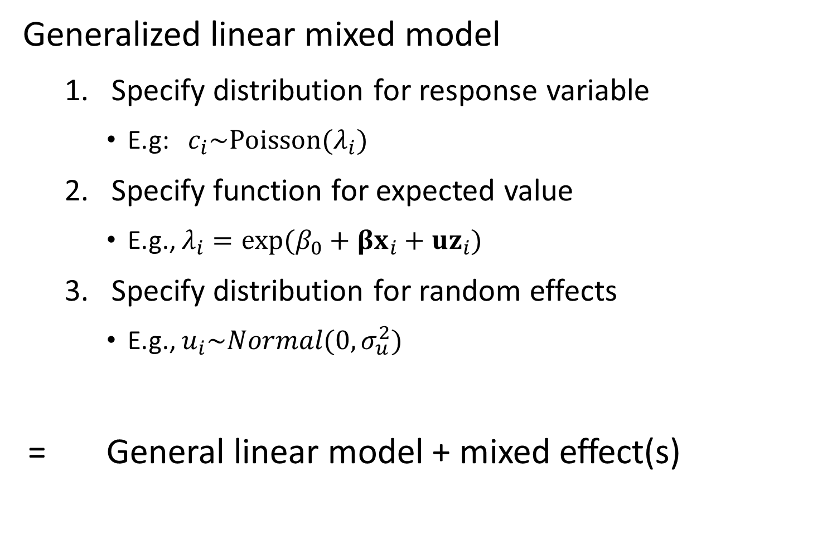
Generalized linear mixed model
Specify distribution for response variable
E.g: $c_{i}\sim Poisson(λ_{i})$
Specify function for expected value
E.g., $λ_{i}=exp⁡(β_{0}+βx_{i}+uz_{i})$
Specify distribution for random effects
E.g., $u_{i}\sim Normal(0,σ_{u}^{2})$
= General linear model + mixed effect(s)

Slide 3
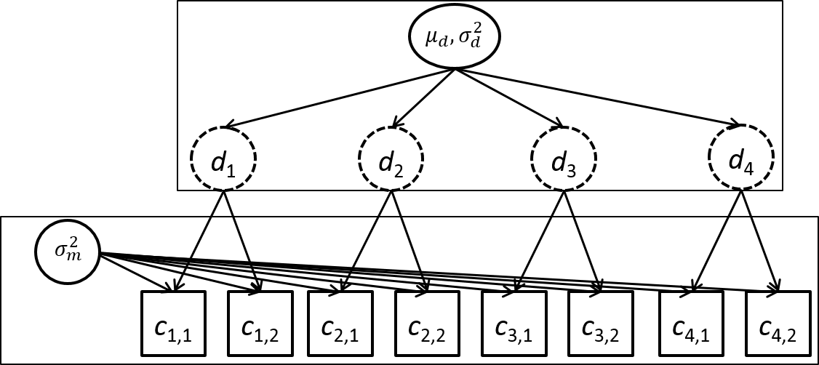
Example #1 – Linear mixed model
4 sites
2 observations/site
3 fixed effects
4 random effects

Slide 4
Simulating data
[See R code]

Slide 5
Fit using R
Using lme4 package
formula: way to specify model
Linear model – lm(formula= … )
Count ~ 0 + factor(Site)
“Count” – response variable
“0” – Don’t include intercept
“factor(Site)” – Include a fixed effect for each site
Linear mixed model – lm(formula = … | … )
Count ~ ( 1 | factor(Site))
“( 1 | factor(Site) )” – Include a random effect for each site

Slide 6
Fit using R
[See R code]

Slide 7
Benefits of using linear mixed models
Separate estimate of measurement and between-site variability
Include covariates for either one
Improved precision
“Shrinkage”
Draw-backs
Biased if random effects aren’t “exchangeable”

Slide 8
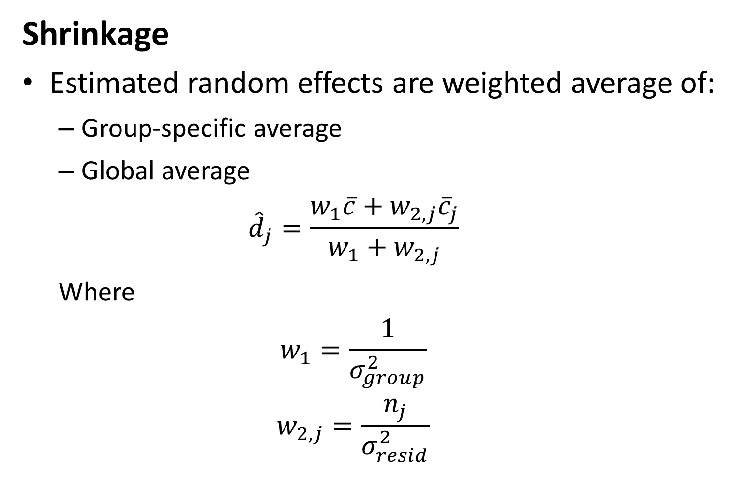
Shrinkage
Estimated random effects are weighted average of:
Group-specific average
Global average
$${\hat{d}}_{j}=\frac{w_{1}\overline{c}+w_{2,j}{\overline{c}}_{j}}{w_{1}+w_{2,j}}$$
Where
$$w_{1}=\frac{1}{σ_{group}^{2}}$$
$$w_{2,j}=\frac{n_{j}}{σ_{resid}^{2}}$$

Slide 9
Fit using JAGS
Define JAGS model
Priors
Probability of random effects
Probability of data
Run and check for convergence
Trace plots
Gelman-Rubin R-hat
Effective sample size

Slide 10
Fit using JAGS
[See R code]

Slide 11
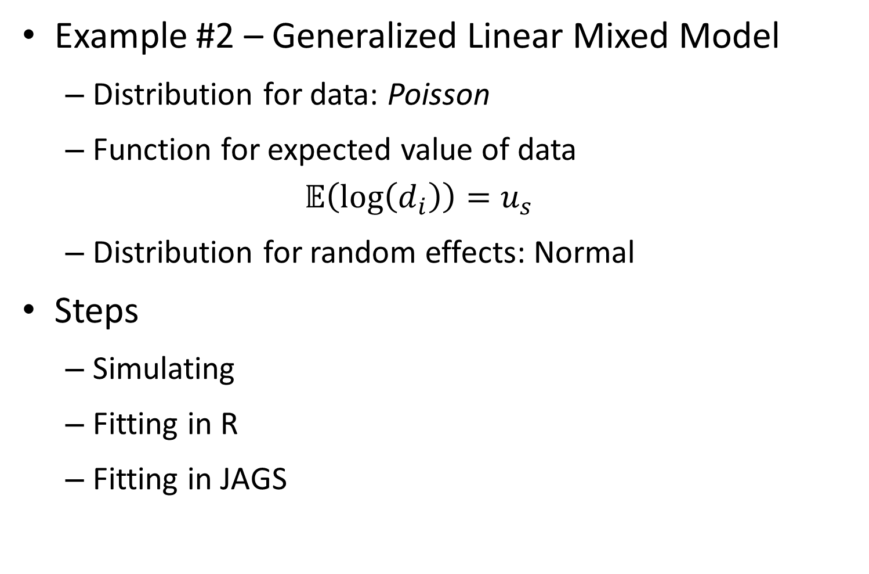
Example #2 – Generalized Linear Mixed Model
Distribution for data: Poisson
Function for expected value of data
$$𝔼\left(\log\left(d_{i}\right)\right)=u_{s}$$
Distribution for random effects: Normal
Steps
Simulating
Fitting in R
Fitting in JAGS

